Slide 1

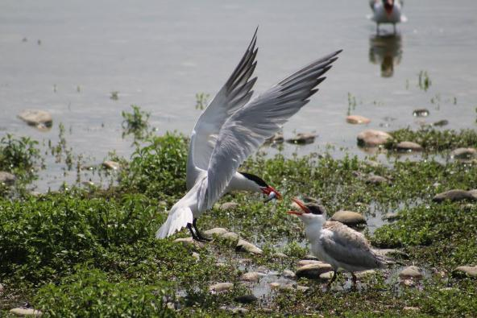

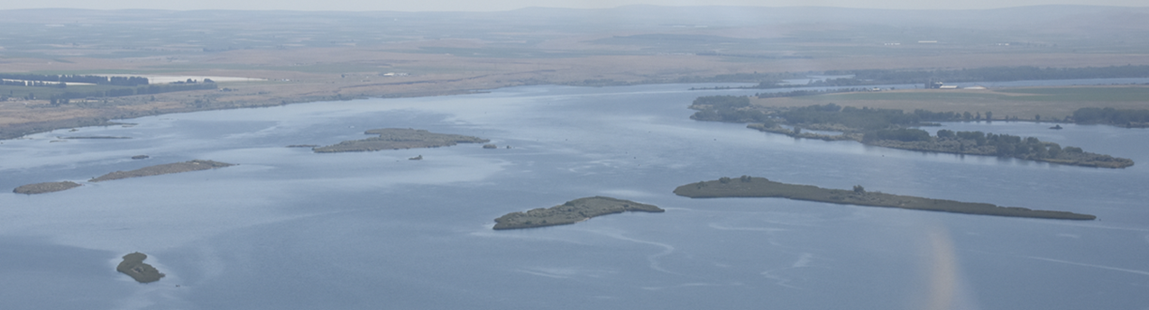
John day pool Raise Measure Blalock Islands complex
2022 AFEP
Annual Review
January 17, 2023
Chuck Barnes
Dave Trachtenbarg
US Army Corps of Engineers
BUILDING STRONG®

Slide 2
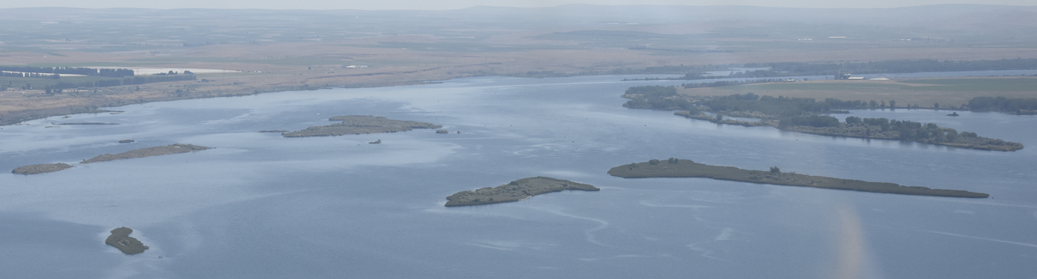
Crs John Day Predator disruption operations
CRS Action
Operate John Day Dam forebay
Within 264.5 to 266.5 range
From April 10 to as late as June 15
2022 Operation
Operation early April to early June
Return to MIP: Early June
262.5-264.5 ft

Slide 3
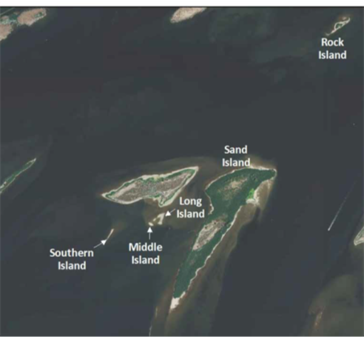
Crs John Day Predator disruption operations
Blalock Island Observations – 2022
No nesting Caspian terns observed via flights
Limited low-lying habitat during 2022 Operation
Limited CATE, DCCO, gulls loafing following return to lower WSE
Additional Observations by OSU/RTR
Photo Taken 24 May 2022
Photo taken 29 July 2022

Slide 4

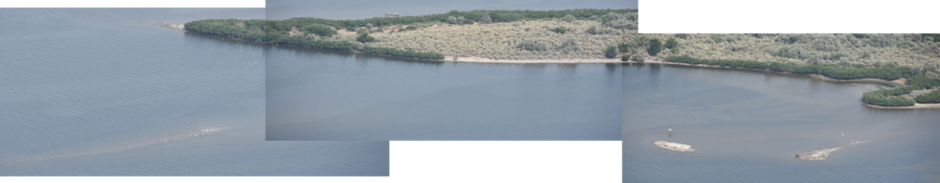
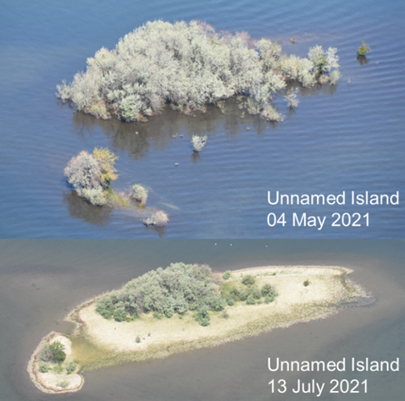
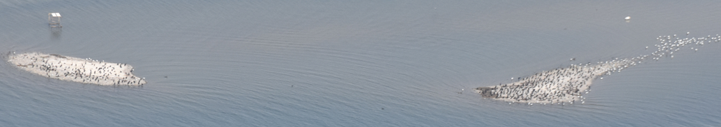
Crs John Day Predator disruption operations 2021
Blalock Island Complex
03 June 2021
South, Middle, Long, and Anvil Islands
13 July 2021
Long and Middle Island
13 July 2021

Slide 5
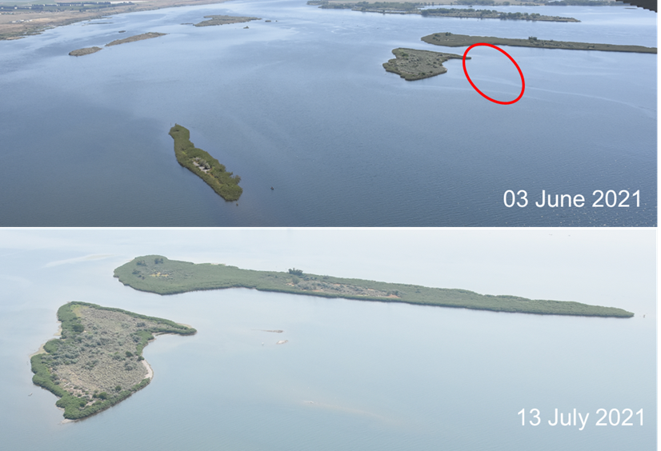
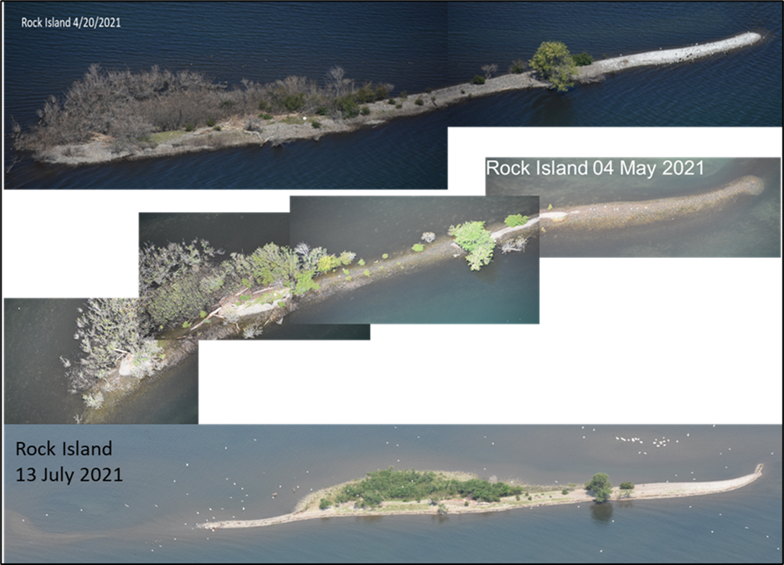
Crs John Day Predator disruption operations 2022

Slide 6
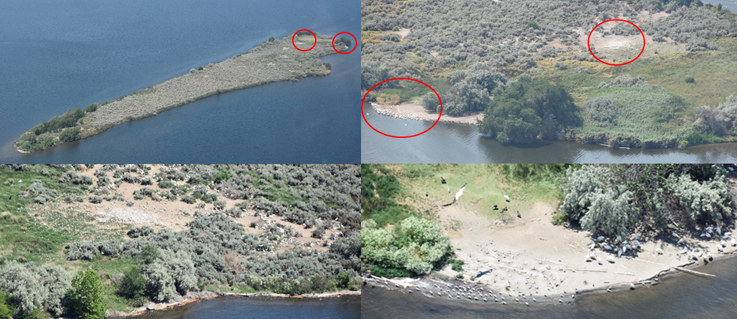
Crs John Day Predator disruption operations
Other Observations in Vicinity
Badger Island Incipient Colony
2021 - Peak ~200 pairs - Two nesting areas
2022 – Peak ~167-267 pairs – One nesting area
Badger Island - 2022
Badger Island
2021

Slide 7
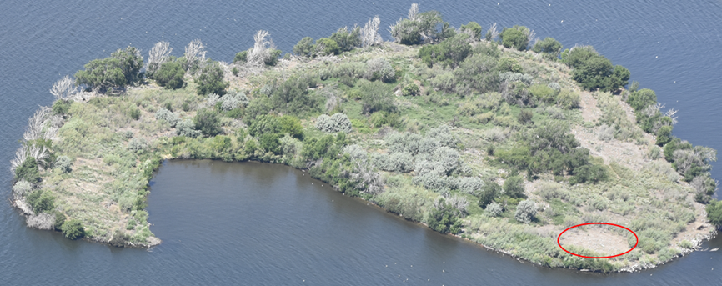
Crs John Day Predator disruption operations
Other Observations in Vicinity
Crescent Island
2021 - One nesting pair – Historic colony area
2022 - ~143-203 pairs – Historic colony area
Crescent Island 2021
Crescent Island 2022

Slide 8
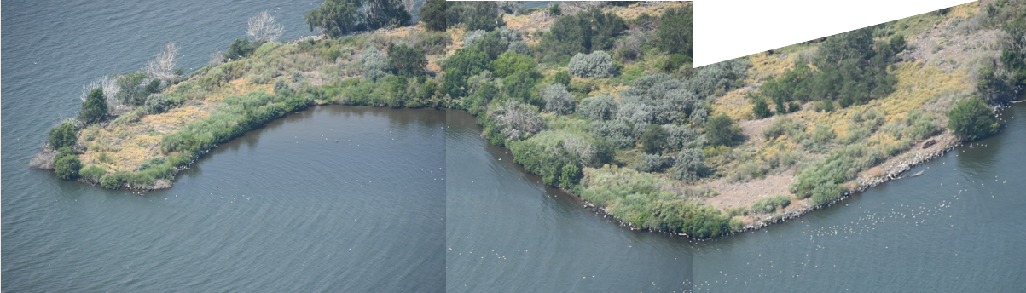
Crs John Day Predator disruption operations
QUESTIONS
Blalock Island Complex
03 June 2021
Crescent Island Spring 2021

Slide 9
Crs John Day Predator disruption operations

Slide 10
Crs John Day Predator disruption operations

